Slide 1

Electronic Sales
Brand v Brand

Slide 2
Brand specific
Should we focus on one brand?
Is one product better?
Who is buying?

Slide 3
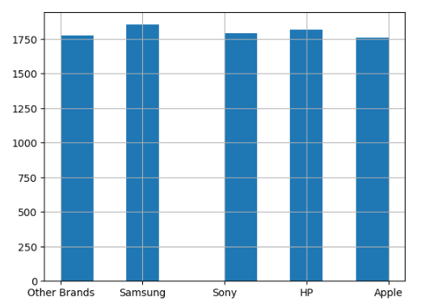
Brand options
Samsung
Sony
HP
Apple
Other Brands
Notes:
When we look at the data of all the brands sold, we can see that as a whole there isn’t a large difference in sales between brands.

Slide 4
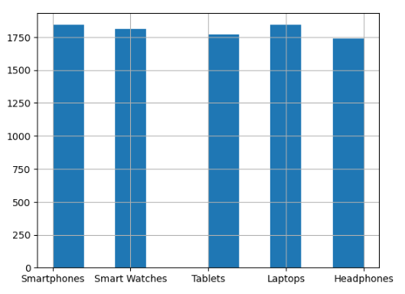
Product options
Smartphones
Smart Watches
Tablets
Laptops
Headphones
Notes:
Based on the consumer data based on products we do see that headphones have the least amount of sales but it is not a great difference.

Slide 5
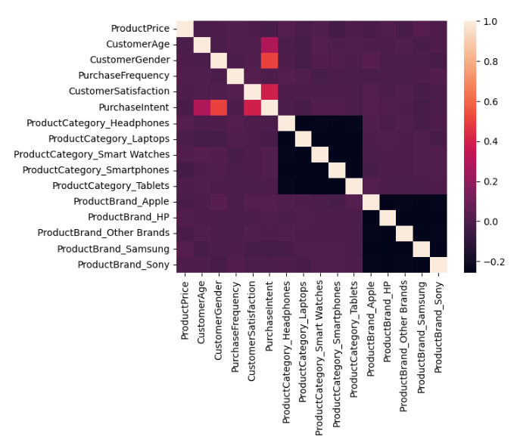
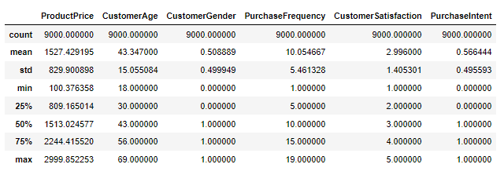
Who is buying?
Everyone
No formal correlation
Notes:
From this heatmap there isn’t great correlation between the product or the brand. Based on the numbers we show a large variety of in age, products and brands.

Slide 6

Conclusion
Variety is the best bet
Notes:
Variety of products and brands will lead to better sales. This can be re-evaluated by area as we move forward. With the general information it can be determined that one product would be better to sale over another.

